Slide 1
NVIDIA

Slide 2
NVIDIA

Slide 3
NVIDIA

Slide 4
NVIDIA

Slide 5
NVIDIA

Slide 6
NVIDIA

Slide 7
NVIDIA

Slide 8
NVIDIA

Slide 9
NVIDIA

Slide 10
NVIDIA

Slide 11
NVIDIA

Slide 12
NVIDIA

Slide 13
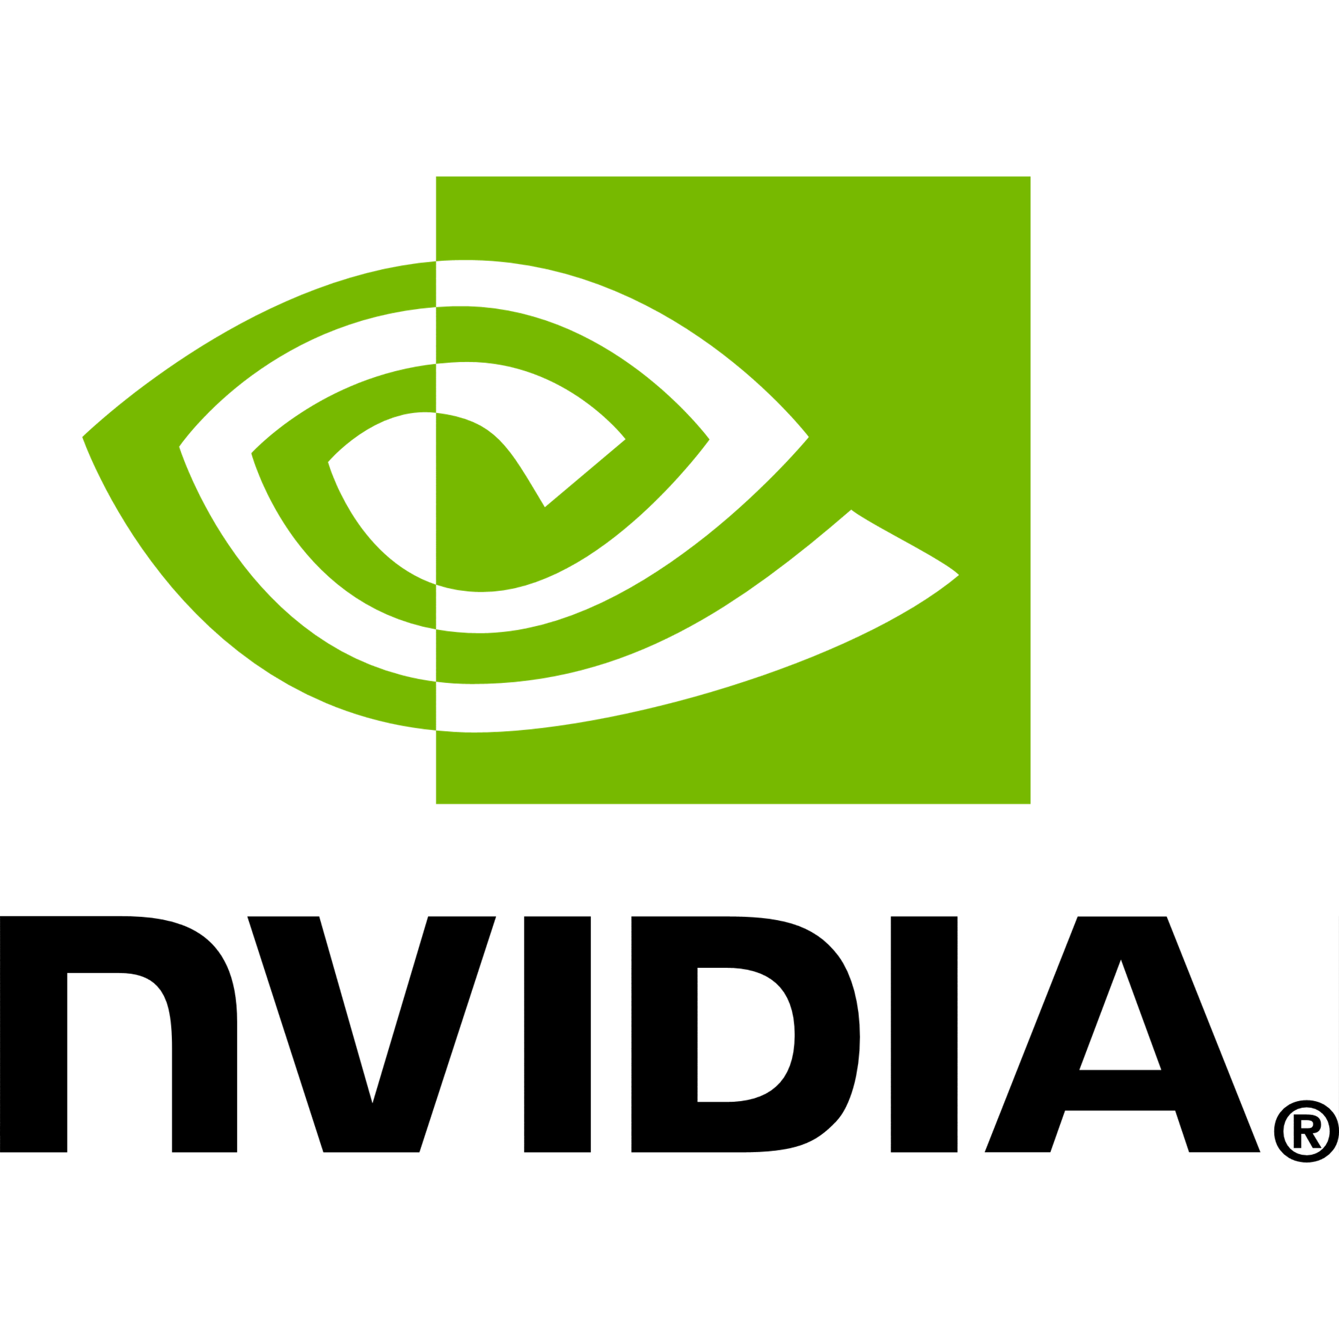

NVIDIA

Slide 14


This is a case study by Aman Rajput.

Slide 15



Problem
Opportunity
Traditional GPU markets (gaming, graphics) were saturating
Surge in demand for AI computing, data centers, cloud services, and autonomous systems created a goldmine
Hypothesis
H1
Hypothesis
H2
NVIDIA is not a chip company. It’s a software company disguised as hardware
NVIDIA’s explosive growth is powered by scarcity economics — not demand
This is a case study by Aman Rajput.

Slide 16
Problem
Opportunity
Traditional GPU markets (gaming, graphics) were saturating
Surge in demand for AI computing, data centers, cloud services, and autonomous systems created a goldmine
Hypothesis
H1
Hypothesis
H2
NVIDIA is not a chip company. It’s a software company disguised as hardware
NVIDIA’s explosive growth is powered by scarcity economics — not demand
This is a case study by Aman Rajput.

Slide 17





Hypothesis
H1
How did a gaming GPU company become the most valuable chipmaker in the world — and the core engine behind AI like ChatGPT?
NVIDIA is not a chip company. It’s a software company disguised as hardware

Slide 18
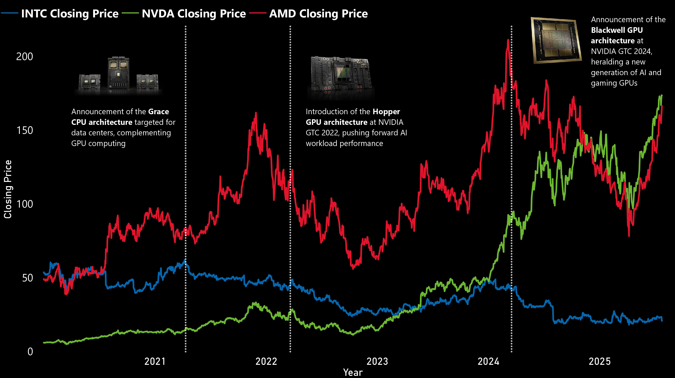

Slide 19
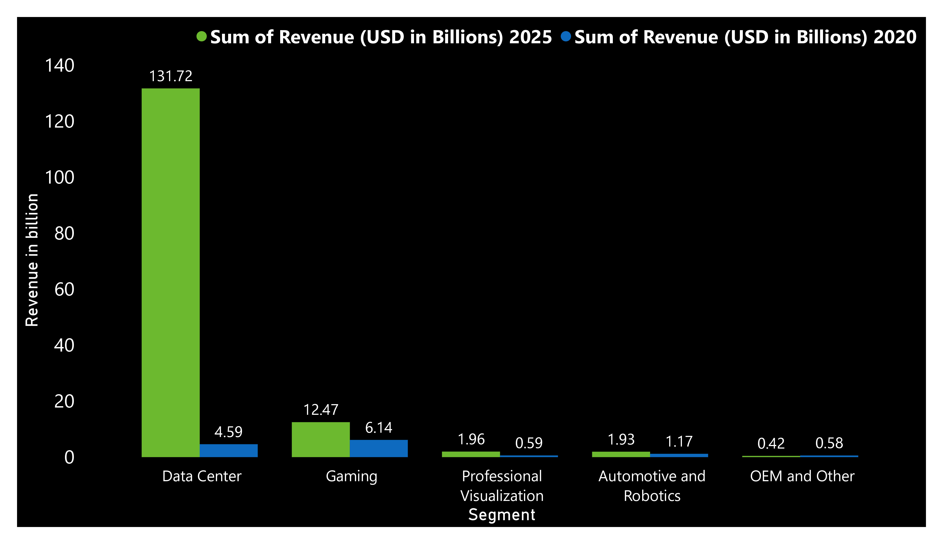



2769%
Increase

Slide 20
Omniverse
NVIDIA AI Enterprise
TensorRT
cuDNN
CUDA

Slide 21
CUDA: The Invisible Cage That Keeps AI Inside NVIDIA

Slide 22
CUDA Launched
NVIDIA introduces CUDA — a new programming model for unlocking the parallel computing power of GPUs
First general-purpose GPU computing platform
The seed that would later dominate AI
2006
2012
2014-16
2020
2023
2025

Slide 23
Deep Learning Breakthrough
AlexNet wins ImageNet using NVIDIA GPUs — DL becomes practical
CUDA + cuDNN enable massive speed-ups in training
DL explosion begins → CUDA becomes the go-to backend
2012
2006
2014-16
2020
2023
2025

Slide 24
Lock-in Begins
TensorFlow, PyTorch, Caffe, Theano — all support CUDA by default
Ecosystem builds on top of CUDA: cuDNN, NCCL, TensorRT
Developers now write CUDA-compatible models → lock-in deepens
2014-16
2006
2012
2020
2023
2025

Slide 25
Enterprise Expansion
NVIDIA launches AI Enterprise suite and DGX Cloud
CUDA becomes the foundation of large-scale AI deployments (e.g., OpenAI, Meta)
Now part of commercial AI infrastructure
2020
2006
2012
2014-16
2023
2025

Slide 26
The ChatGPT Era
OpenAI’s ChatGPT runs on NVIDIA’s A100/H100 — powered by CUDA
NVIDIA becomes central to global LLM deployment
Explosion in data center revenue (from $10B → $45B in 2 years)
2023
2006
2012
2014-16
2020
2025

Slide 27
CUDA Monopoly Solidified
CUDA controls around 80–90% of the AI training market
AMD’s ROCm adoption remains niche; Intel’s OneAPI barely used
No serious AI stack exists without CUDA
2025
CUDA started as a GPU tool — now it’s the backbone of modern AI infrastructure
2006
2012
2014-16
2020
2023

Slide 28
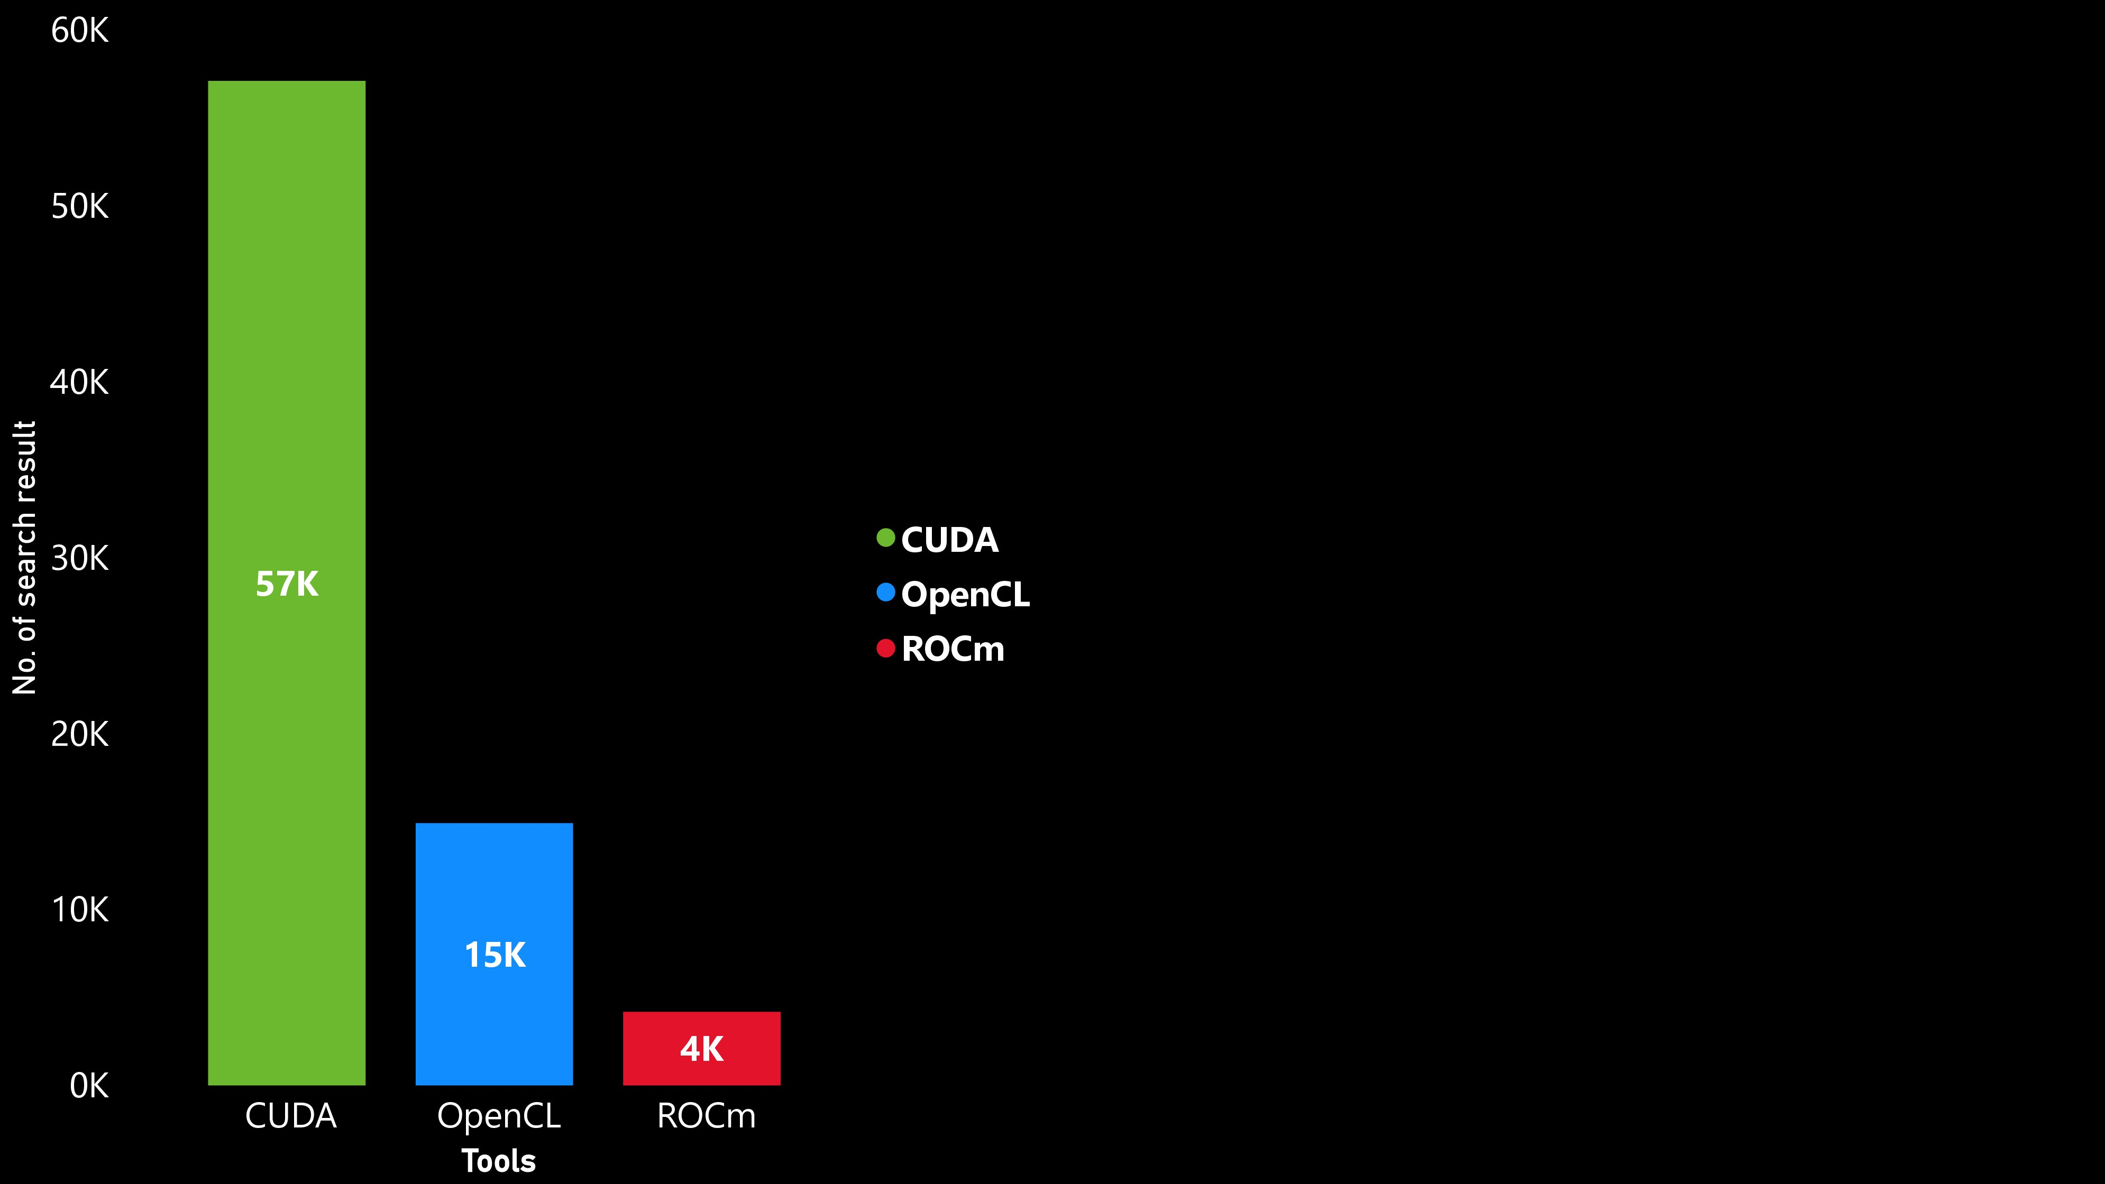
Same Hardware Race, Different Finish Line
Market Share in AI
~92%
~8%
Less than 1%
Software Suite
Full-stack
Weak ROCm
Fragmented
AI Developer Ecosystem
Strong (CUDA)
Weak
Weak
Hardware Quality
High
High
Good
Company
NVIDIA
AMD
Intel
CUDA IS THE MOAT, NOT THE SILICON

Slide 29
Same Hardware Race, Different Finish Line
Company
Hardware Quality
AI Developer Ecosystem
Software Suite
Market Share in AI
NVIDIA
High
Strong (CUDA)
Full-stack
~92%
AMD
High
Weak
Weak ROCm
~8%
Intel
Good
Weak
Fragmented
Less than 1%
CUDA IS THE MOAT, NOT THE SILICON

Slide 30
What Makes NVIDIA More Like Microsoft Than Intel?
AMD
Mostly chip sales
Weak
N/A
Microsoft
Office, Azure
VS Code, GitHub
Windows + Azure
NVIDIA
AI software licenses, enterprise stack
CUDA, cuDNN
Omniverse, DGX Cloud
Feature
Recurring revenue
Developer ecosystem
Platform effect

Slide 31
What Makes NVIDIA More Like Microsoft Than Intel?
Feature
NVIDIA
Microsoft
AMD
Recurring revenue
AI software licenses, enterprise stack
Office, Azure
Mostly chip sales
Developer ecosystem
CUDA, cuDNN
VS Code, GitHub
Weak
Platform effect
Omniverse, DGX Cloud
Windows + Azure
N/A

Slide 32
What Makes NVIDIA More Like Microsoft Than Intel?
Hypothesis
H2
How did a gaming GPU company become the most valuable chipmaker in the world — and the core engine behind AI like ChatGPT?
NVIDIA’s explosive growth is powered by scarcity economics — not demand

Slide 33
Veblen Good

Slide 34
40
Veblen Good
30
Prices
20
Normal Good
10
0
10
20
30
40
Quantity of demand

Slide 35
40
Veblen Good
30
Prices
20
NVIDIA’s explosive growth is powered by scarcity economics — not demand.
10
Normal Good
0
10
20
Quantity of demand
30
40

Slide 36
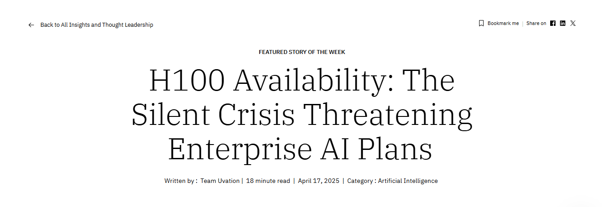

Slide 37
6–12 month lead times for H100 GPUs, even amid high demand

Slide 38



How Do Nvidia Allocations Work?
hey we would like 10,000 H100s all to be used by Inflection
Clouds might be able to get an extra allocation for a specific end customer if Nvidia is excited about the end customer.
hey we would like 10,000 H100s for Azure’s cloud

Slide 39
How Artificial Scarcity Translates into Pricing Power

Slide 40
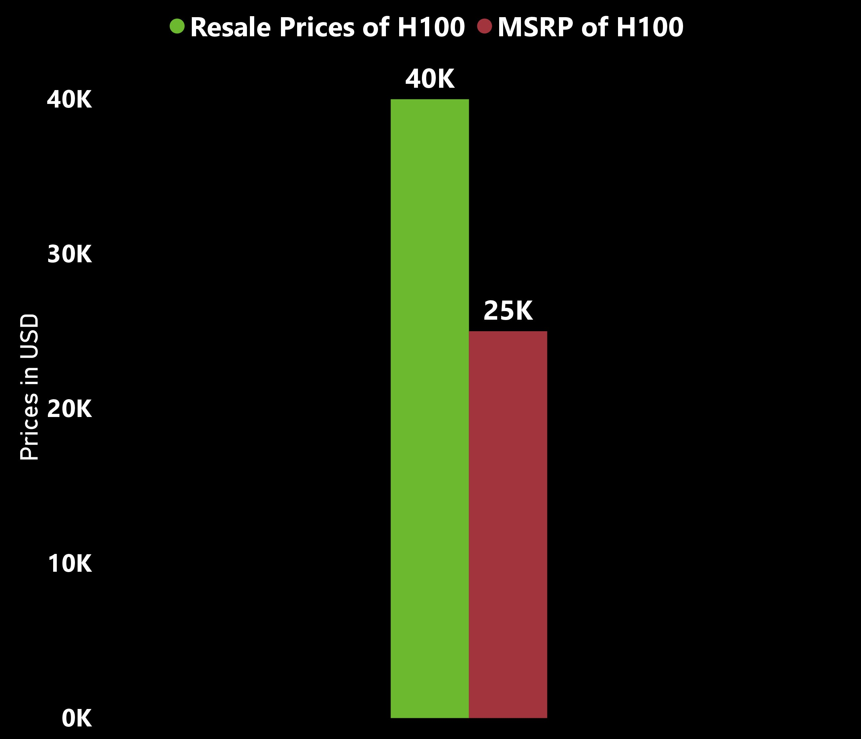
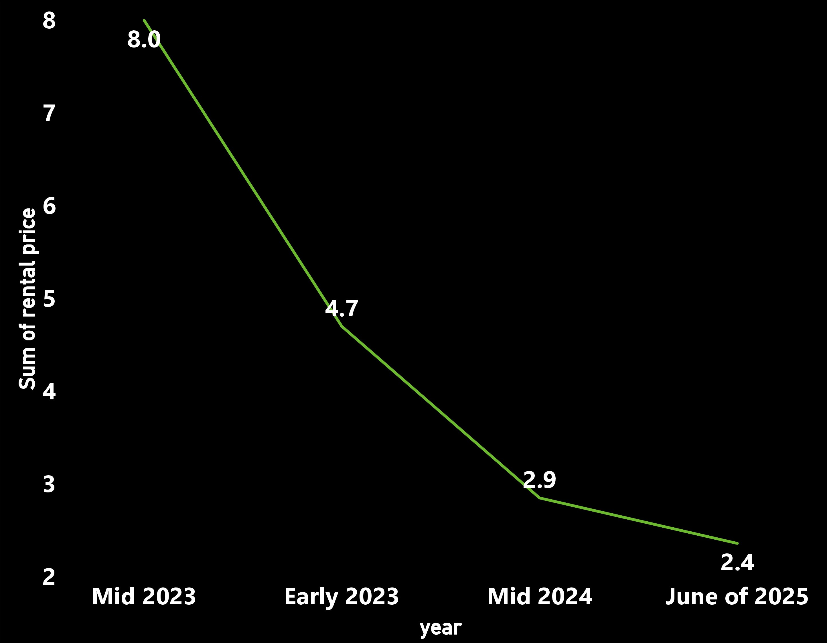
H100 Resale Prices vs MSRP
Cloud Rental Pricing Trends
(H100 Hourly Rates)
Notes:
At peak demand (Mar–May 2023), GPU farm rental contracts surged—many companies prepaid months of capacity at rates over $8/hour
Scarcity enabled peak prices: When supply was limited, rates soared and providers locked in high-paying clients via contracts
DISCUSS THE VEBLEN GOODS

Slide 41
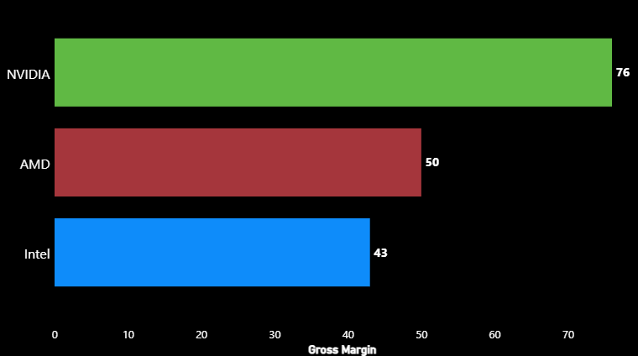
Scarcity + CUDA + DGX Bundles
Lower pricing power in AI chips
Commoditized CPU + lag in AI
FY2024

Slide 42
CONCLUSION
“While demand for AI chips is real, NVIDIA’s margins and growth are disproportionately high due to an engineered scarcity play. With limited supply, selective partnerships, and control over foundational software like CUDA, NVIDIA isn't just selling chips — it's creating digital luxury.”

